Slide 1
pb2a monitor observations
On Chile 2020/03/01 Data
Kyle Devereaux

Slide 2
Methods
Data taken from /data/pb2/ChileData/databases/pb2a-20200301/pb2a_monitor.db. I chose this date since it also has weather data given in pb2a_apex.db. This data includes temperature, humidity, pressure, wind data, etc. and was used to compare with the same measurements from the monitor.
The monitor data set is too massive to compare set-by-set, so a different method was needed. Data sets with a similar characteristics (i.e. primary, secondary, SC, or iceboard type data), were grouped. Correlations within the groups were computed, and if the group was well correlated, one set of data set was chosen from the set to compare to other groups. Furthermore, using different fit types and correlations, the most interesting relationships within a set were found and documented.
This narrows search down from ~1900 data sets to a few hundred. When only considering the mean and sets-by-set comparisons containing many corresponding points, the number of sets to consider drops to a few dozen.
For these remaining sets, I manually comb through each combination of sets and document the interesting relationships.
Notes:
Note: two points in two datasets (columns of the montior databases) only correspond if they have the same run_id and run_subid
Icecrate_mux_1 and icecrate_mux_2 sets have no data in common with other sets.

Slide 3
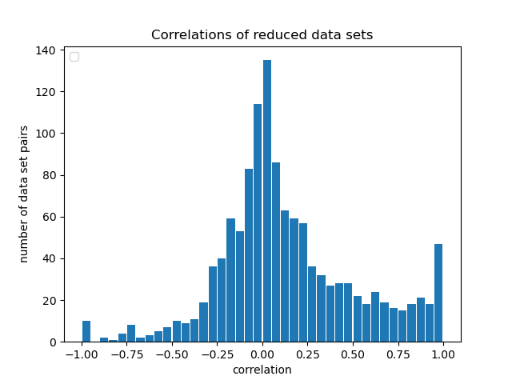

Most data has low correlation
Once the set of all data sets is simplified as described before, the distribution of set-by-set correlations is given by a gaussian distribution (see below) with little skewing. Specifically, the Pearson correlation coefficient was used.
So, the vast majority of the data has little to no correlation. To simplify the analysis of each set-by-set comparison further, only set-by-set pairs with correlations >0.75 were considered.

Slide 4
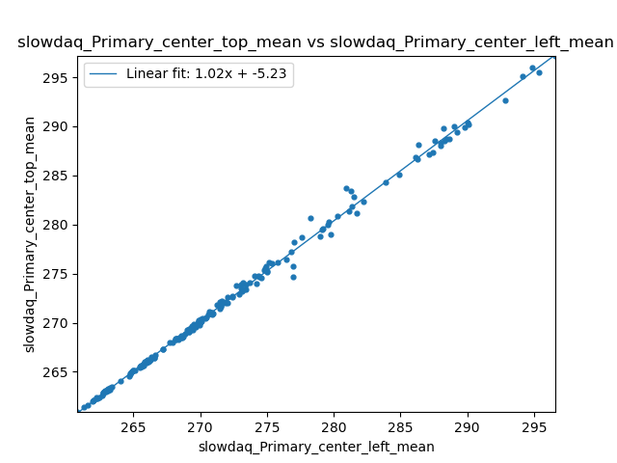
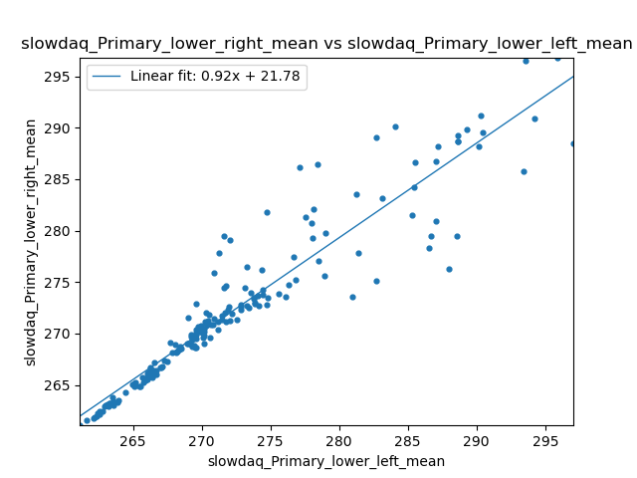
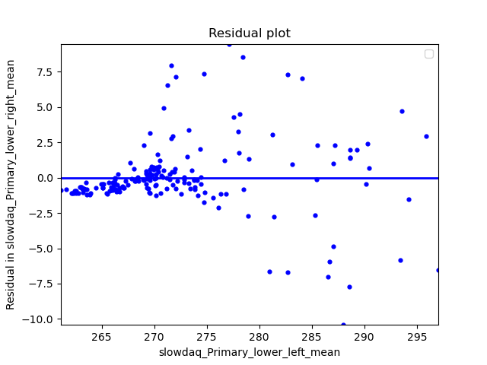
Primary data is correlated well at lower temps
Left: best correlated sets
Right: worst correlated set. Notice the large increase in variance when temperature >270K. This happens somewhat in all Primary-Primary set comparisons.
center _bottom sensor broken (reads only zero)

Slide 5
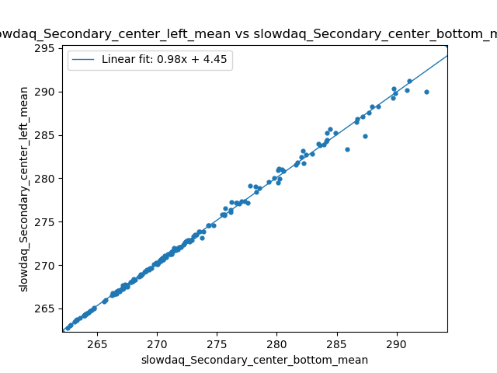
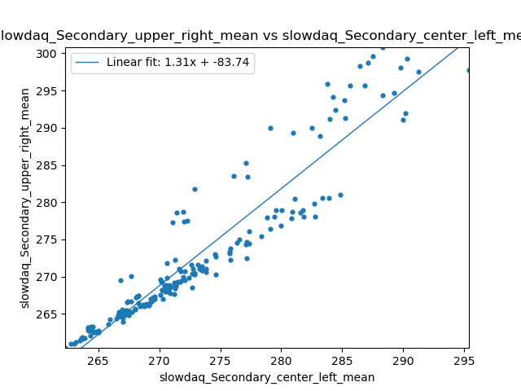
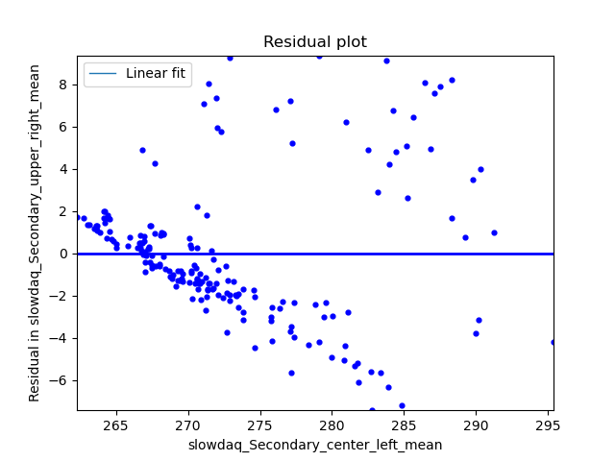
Secondary data is correlated well at lower temps, similar to Primary data, high temp variance is predictable
Left: best correlated sets
Right: worst correlated sets. Notice the data splits into what seems like two seperate lines, one above the line y=x, and one under (this is exaggerated in the residual plot). The line y=x is the expected (see left) since we expect the temperature across the secondary to be homogenous. This splitting only happens for sets including the upper_right sensor. Note the average (linear fit) is still implies homogeneity.

Slide 6
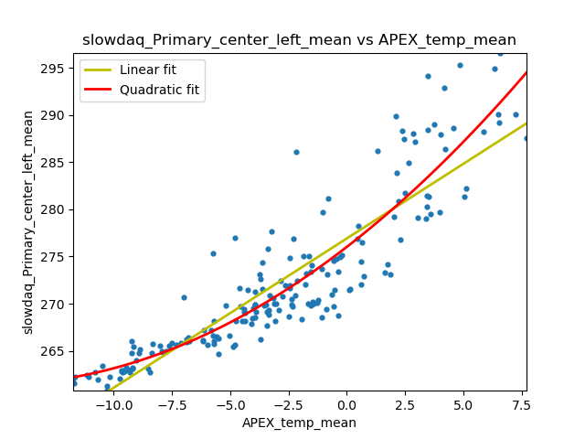
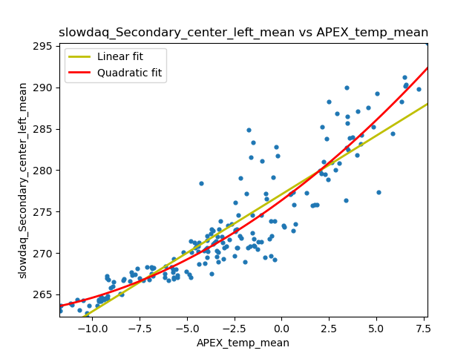
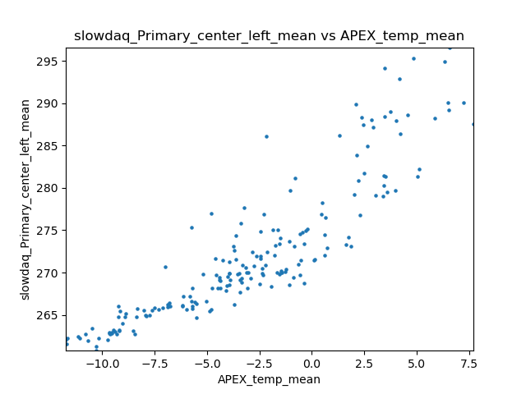
Temperature relations to the primary and secondary
The temperatures for primary and secondary are correlated, but very poorly. It’s expected that the primary and secondary temperatures are proportional (and equal) to the outside apex temperatures. In fact, they seem to have a non-linear relationship. For example, above they are fitted with a linear fit and a quadratic fit. The error for the quadratic fit is much less than that of the linear fit.
Note: Apex in degree C, primary/secondary in K

Slide 7
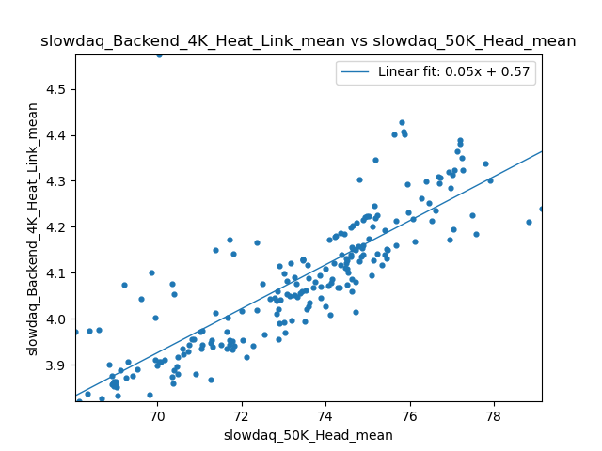
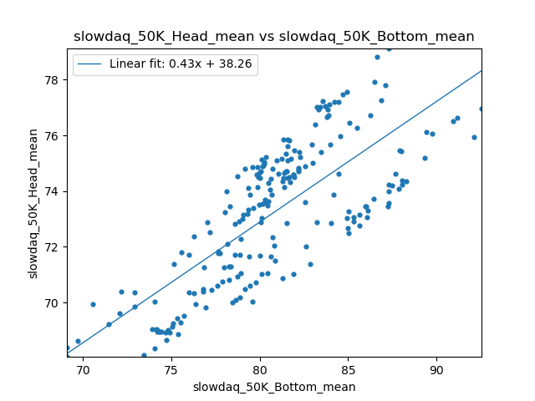
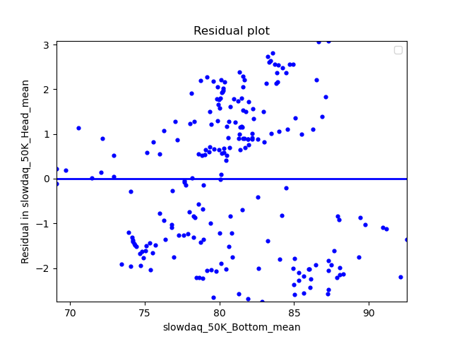
50K layer temperature data: large difference in component temperatures, but still proportional
Left and middle: the bottom and head components of the 50K layer consistently have a temperature considerably higher than 50K - up to 90K in the case of the “bottom” data. Despite there being high correlation of these two components there is a high variance in the temperatures (see residual on the right). Furthermore, 4K components (such as the heat_link in the left figure) have high correlation to these two components. Temperatures of these 50K components may adversely affect the temperatures of 4K layer components.

Slide 8
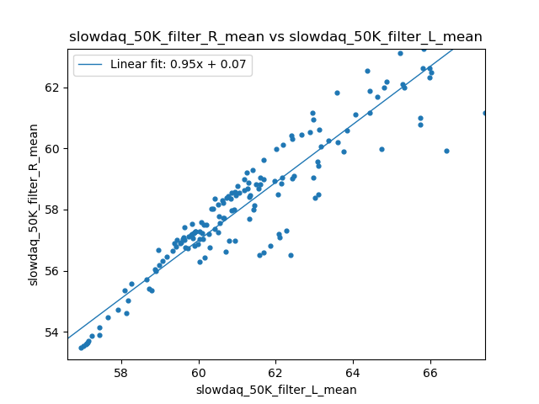
50K layer temperature data: filter data has large left-right difference
Left: the left 50K filter and right 50K filter have high correlation however the left data is offset from the right data by ~4K, a fairly large temperature difference.

Slide 9
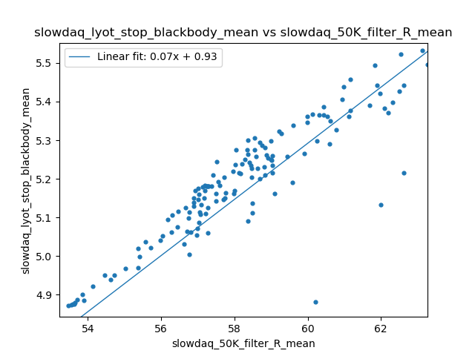
4K layer temperature data: lyot stop temperature is high
While the lyot stop is in the 4K region, it’s temperature is consistently >4.9K. Furthermore, like most 4K layer components it’s related proportinally to the temperature of various 50K component temperatures (here is the right 50K filter temperatures, which is proportional to all other 50K layer components as described earlier.

Slide 10
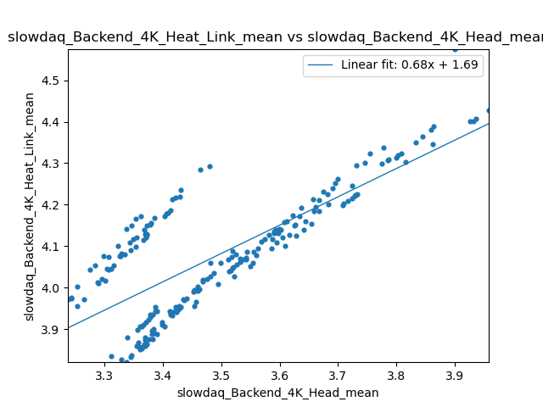
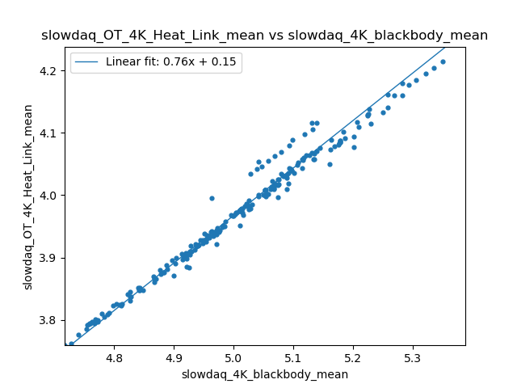
4K layer temperature data: high variance in temperature across components
Similar to the lyot stop temperature data, other components in the 4K layer can have temperatures varying greatly (~1 K) and can be as high as (5.5K in the case of the loyt stop). For example, the 4K heat link and 4K blackbody (see right) are proportionally related, but the blackbody averages ~1K greater than the heat link’s temperature. Furthermore, often two subsets of the data within a set of runs (“two distinct lines”) can be seen for a certain set-by-set comparison (see left for example) with very different temperature correlation.

Slide 11
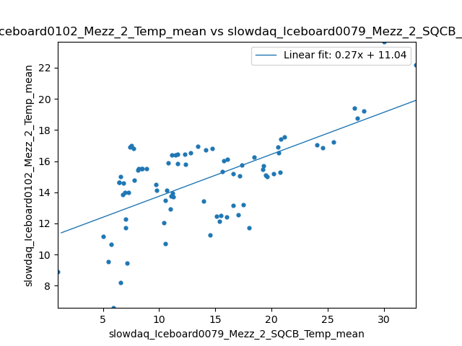
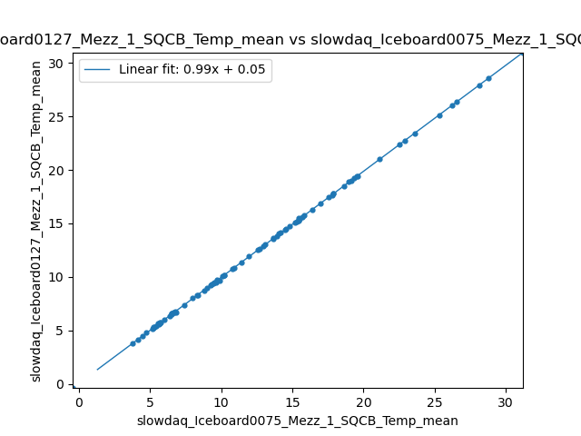
Iceboard components have high temperature correlation
Worst correlation (0.64082) Best correlation (0.99997)
Despite some sets having poor correlation (like the sets in the left figure), the average correlation of the data set is 0.9009 (very high)

Slide 12
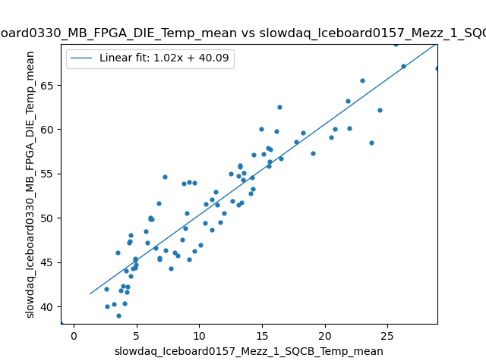
Iceboard components can differ in instantaneous temperature up to 40K, vary about 25K over runs
Above: components with the highest temperature difference. Note the data is still highly correlated. So, at all times, Iceboard330_MB_FPGA_DIE is about 40K warmer than Iceboard0157_Mezz_1_SQCB
Correlation: 0.92917 y-intercept (~difference between components): 40.08507K

Slide 13
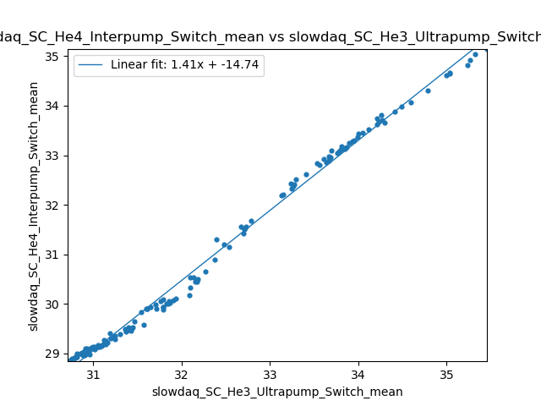
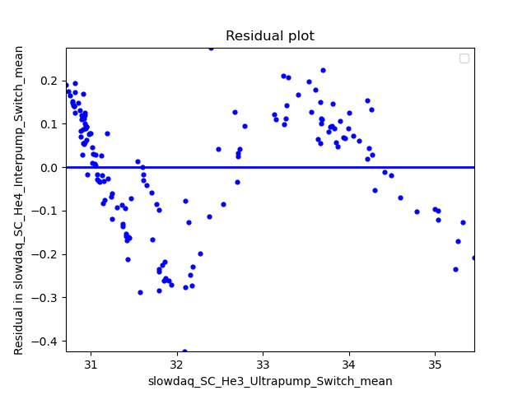
SC data: interpump and ultrapump switch data
The interpump and ultrapump data are very well correlated in general. The interpump data averages about 2K less than the ultrapump data.
The He4 interpump and He3 ultrapump have an interesting correlation as seen above. Their relationship is macroscopically linear, but the residual plot shows a oscillatory relationship with an amplitude of ~0.25K

Slide 14
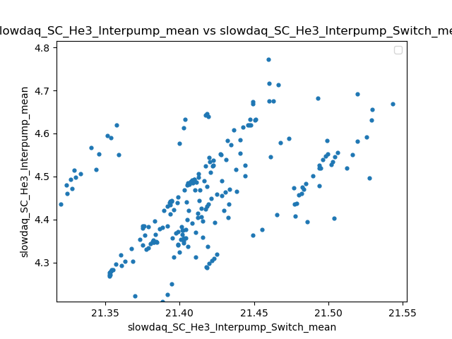
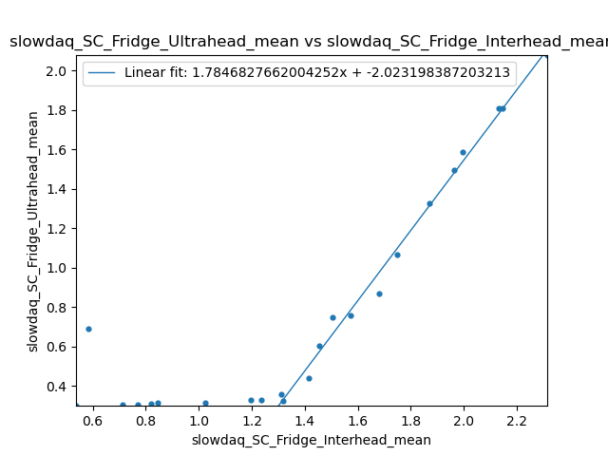
SC data: interhead and ultrahead data
Left: there is little correlation between the interpump and interpump_switch temperatures. Both vary very little with respect to each other. The same is representative of the ultrapump temperature data. The inter_pump switch temperature is about 17K greater than the interpump temperature.
Right: The interhead temperature is consistently greater than the ultrahead temperature. The ultrahead and interhead temperatures are proportional for interhead temperatures > 1.4K. At <1.4K, the ultrahead temperature is a constant 0.2K.

Slide 15
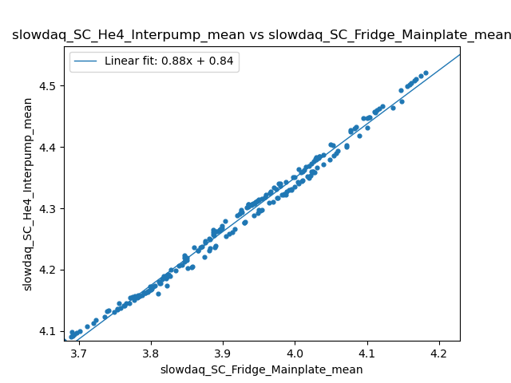
SC data: pump and mainplate data
Given a run, all interpump and ultrapump components differ in temperature by no more than ~0.2K, except for the interpump/ultrapump_switch data which have an average temperature of about 21K.
Above: two distinct lines can be seen with a ~0.02K difference in the He4_interpump temperature. The interpump temperature is about 0.8K above the mainplate temperature, and they are proportionally related.

Slide 16
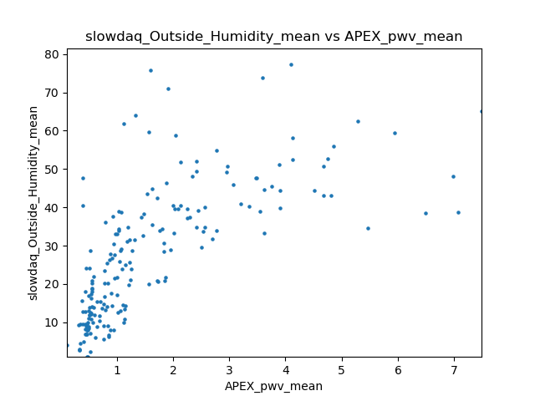
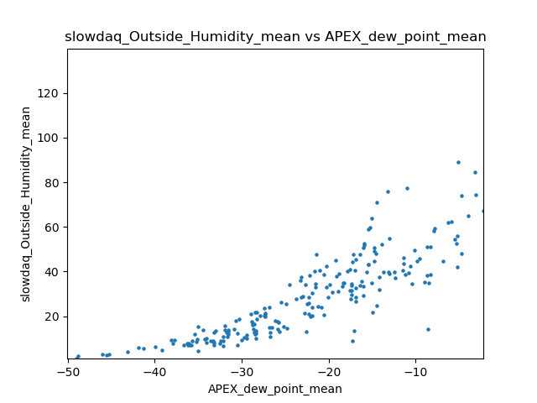
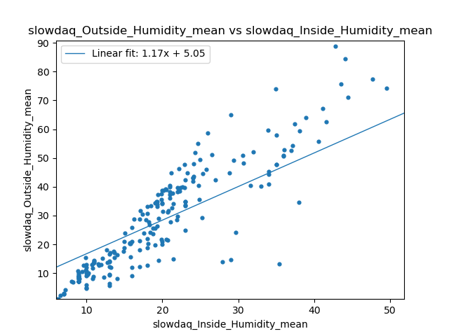
Apex weather data relates with slowdaq measurements closely, humidity varies
Above: APEX and slowdaq measurements are very similar for temperature, pressure and humidity data (graphs aren’t shown, the data sets are very similar). Pressure and humidity and precipitable water vapor are related in the expected meteorological ways (see above).
Right: The inside and outside humidities have unexpectedly low correlation.

Slide 17
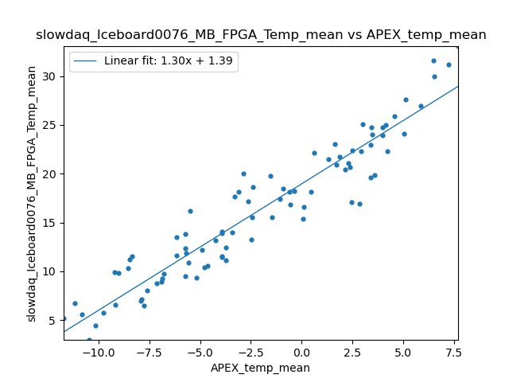
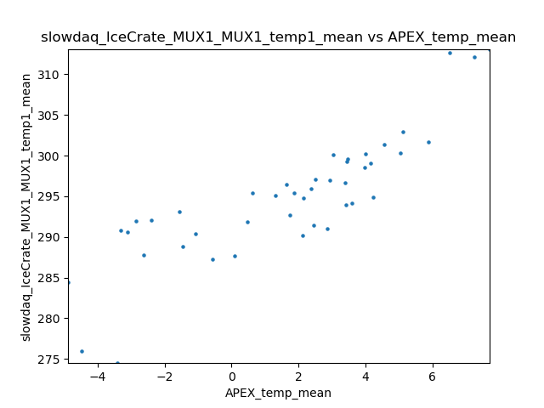
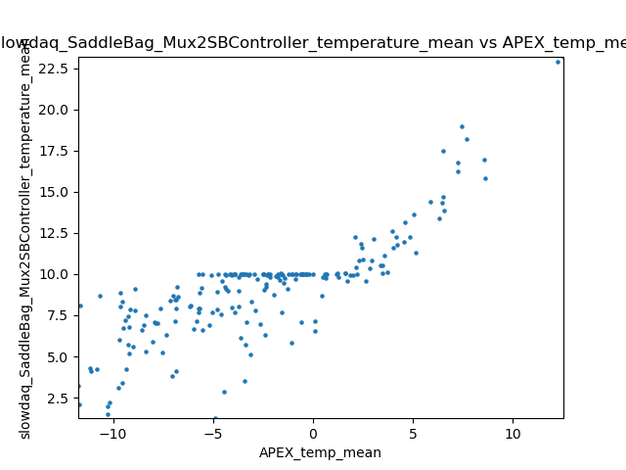
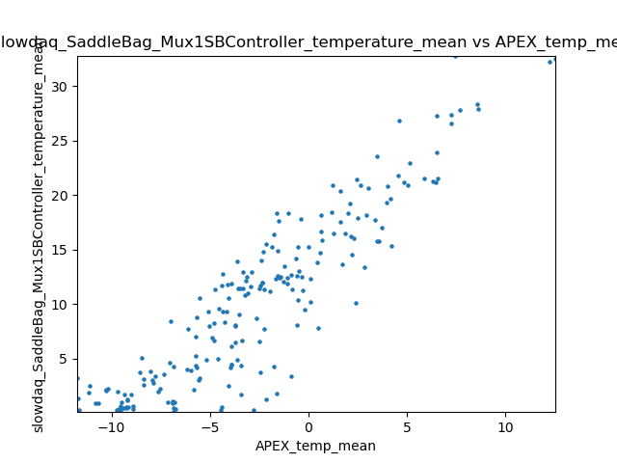
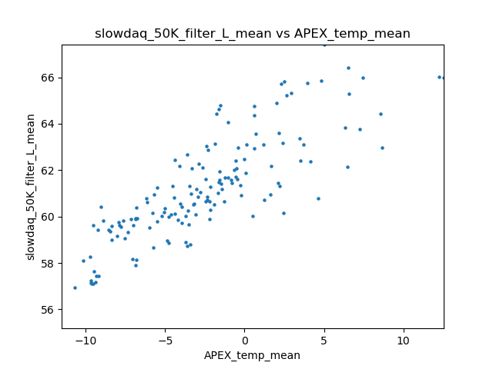
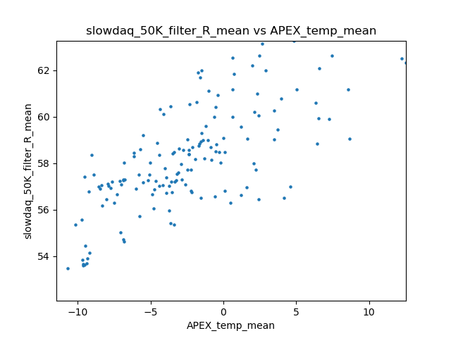
Weather’s relation to components outside refrigerator is expected (high correlation)
Above: Iceboard component temperatures (represented by the 0076 MB FPGA set) are proportionally related to the outside apex temperature (with a high correlation).
Right: the highest linear correlations between apex temperature and other non-iceboard components.
Note: the SaddleBag_Mux2SBCController sensor seems to have malfunctioned for several runs - maxing out at 10K

Slide 18
Summary / expanding this study / code
The temperatures of components in the 4K layer may vary by a large amount and are not directly proportional in some cases. This goes for 50K layer components too, in general. Temperatures across the primary and secondary surfaces vary greater at higher outside temperatures, and in general get hotter in a slightly non-linear way. Temperature relates proportionally with components outside the refrigerator; temperatures of these components are highly correlated in themselves. And certain pump/refrigeration component temperatures vary with respect to others in interesting ways.
This analysis can easily be extended to the monitor data for all observation dates and other observation sites, however I’ve found all dates have roughly similar relationships. One possibly interesting extension would be to find cross-date and cross-site patterns in the monitor data.
The code used for this analysis can be found here.

